Slide 1

Transfer learning for emotion detection
Week 11 Mini Survey Luis Alberto Portilla López

Slide 2
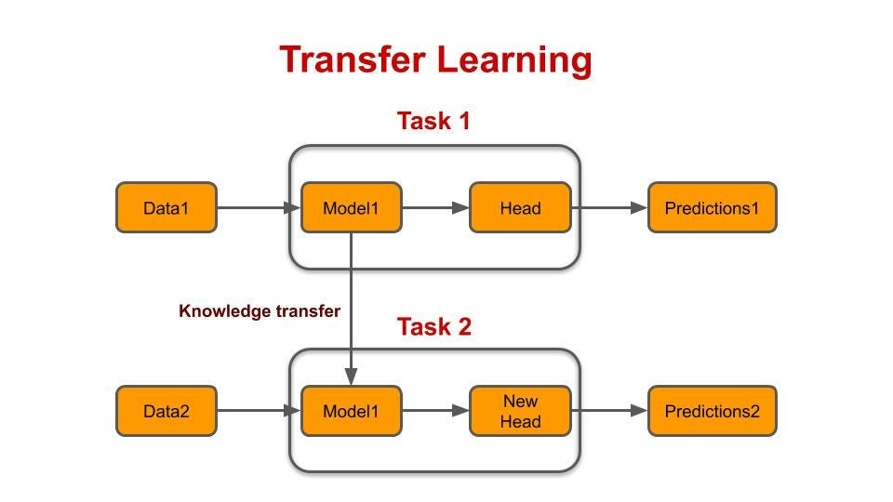
Transfer Learning
Machine learning technique where knowledge gained from training a model on one task is reused to improve performance on a different but related task

Slide 3

Search Methodology & Criteria
Keyword Search
Boolean Search
Citation Chaining and Forward Citation
CRITERIA:
• Initial review of abstracts to assess relevance based on the title, publication venue, and year.
• Direct and indirect relevance to the paper being cross-referenced through the abstract.
• Consideration of the number of citations and field-weighted citation impact (fwci), a metric that measures the citation impact of a paper adjusted for disciplinary differences.

Slide 4

Preliminary Terms
Key terms identified during the week:
Source Domain
• Fine-tuning
• Feature Extraction
• Transfer loss

Slide 5


Document Comparison
“Transfer Learning”
“Emotion Detection in Text: A Review”
“Meta Transfer Learning for Emotion Recognition”

Slide 6
Category | Transfer Learning | Emotion Detection in Text: A Review | Meta Transfer Learning for Emotion Recognition
Primary Focus | Exploring methods and challenges in applying transfer learning to new tasks. | Survey of methods for detecting emotions in text with a focus on linguistic complexities. | Proposing PathNet-based transfer learning for emotion recognition across domains.
Evaluation Metrics | Improved performance, faster learning, higher accuracy in target tasks. | Accuracy, F-measure, precision/recall (varied by cited methods). | Accuracy, precision, recall, F1-score.
Datasets Used | General discussion; no specific datasets mentioned. | ISEAR, EmotiNet, Twitter datasets, SemEval-2007. | SAVEE, EMODB, eNTERFACE.
Techniques Employed | Inductive transfer, Bayesian methods, hierarchical transfer. | Supervised learning, lexicons, vector embeddings, sentiment-specific methods. | Meta transfer learning, domain adaptation, neural networks.

Slide 7
Category | Transfer Learning | Emotion Detection in Text: A Review | Meta Transfer Learning for Emotion Recognition
Key Contributions | Overview of transfer learning methods and their application to various ML tasks. | Detailed overview of challenges and methodologies in emotion detection. | Improved emotion recognition across datasets using PathNet-based approach.
Novelty | Detailed categorization of transfer methods and discussion on avoiding negative transfer. | Emphasis on implicit emotional expression and metaphorical language challenges. | Application of meta-transfer learning to emotion recognition with empirical validation.

Slide 8
References
Zhang, L., Wang, S., & Liu, B. (2018). Deep learning for sentiment analysis: A survey. Wiley Interdisciplinary Reviews: Data Mining and Knowledge Discovery, 8(4), e1253.
Medhat, W., Hassan, A., & Korashy, H. (2014). Sentiment analysis algorithms and applications: A survey. Ain Shams Engineering Journal, 5(4), 1093-1113.
Wang, Q., Liu, P., Zhu, Z., Yin, H., Zhang, Q., & Zhang, L. (2019). A text abstraction summary model based on BERT word embedding and reinforcement learning. Applied Sciences, 9(21), 4701.

